Slide 1
input
LTI
system
output

Slide 2
input
LTI
system
output
U(s)
Y(s)=G(s)U(s)
G(s)

Slide 3
transfer function 1
transfer function 2
branch point
summing point
G₁(s)
U(s)
Y(s)
+
G₁(s)
G₂(s)
U(s)
+
Y(s)
G₂(s)
Y(s) =G₂(s) G₁(s) U(s)
Y(s) =(G₂(s)+G₁(s))U(s)

Slide 4
U(s)
Y(s)
G(s)
+
-

Slide 5
U(s)
Y(s)
G(s)
+
-

Slide 6
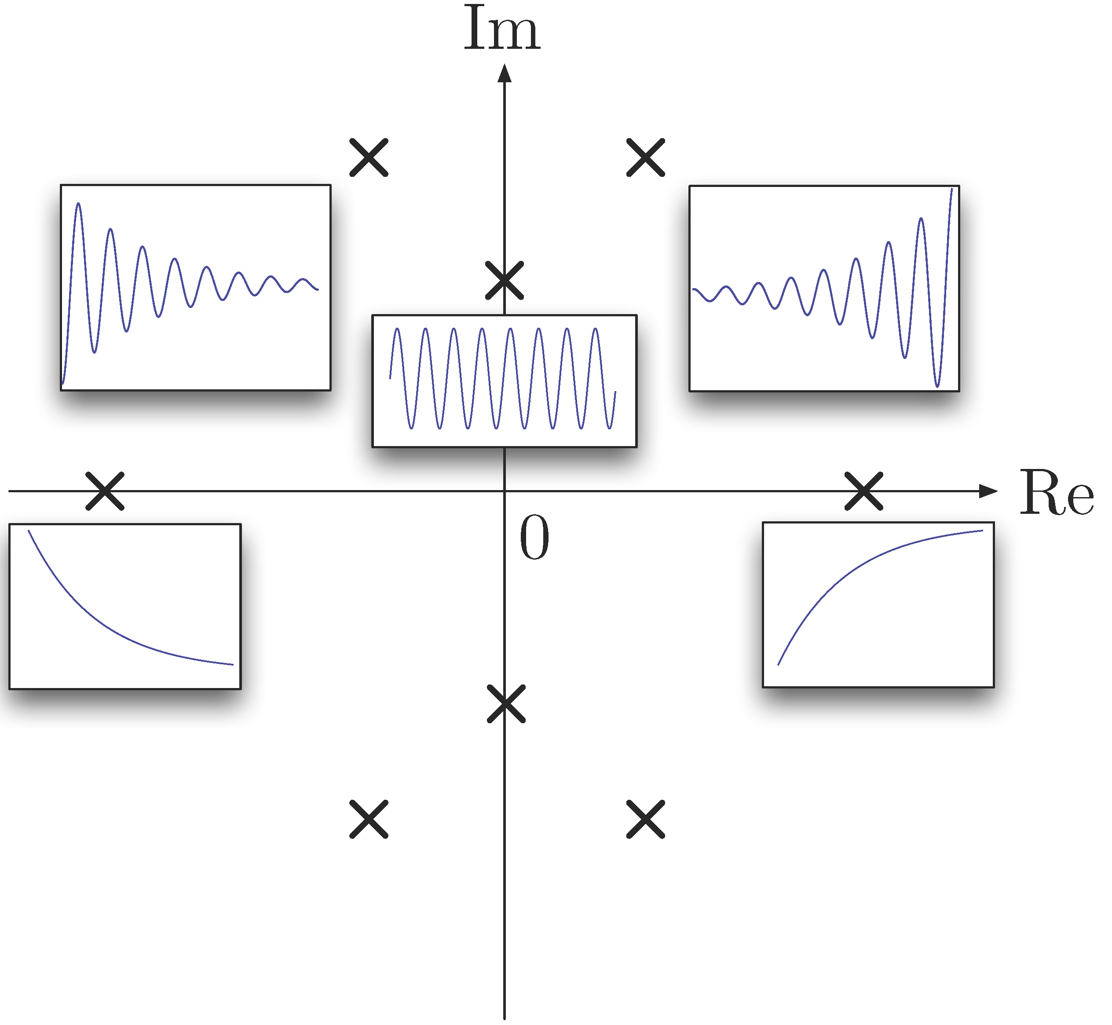
Stable region
Unstable region

Slide 7



$$20\log_{10}{|G(jω)|}$$
$$20\log{\frac{5}{8}}$$
-20dB/dec
-40dB/dec
-20dB/dec
$$ω$$
2
4
5

Slide 8
Gain controller
Desired angle
Wheel angle
K_{p}
Controller
DC motor
Prize wheel
+
-
error
Position
sensor
Wheel angle
Sensor noise

Slide 9
Desired angle
Wheel angle
Controller
DC motor
Prize wheel
R(s)
Y(s)
C(s)

Slide 10
PID controller
Desired angle
e(t)
u(t)
Wheel angle
+
C(s)
DC motor
Prize wheel
r(t)
-
Error
Control
Input
P(s)
Measured angle
y(t)

